Slide 1
Team Unicorn What is a unicorn, anyway?
IPO Price and Performance Analysis using Yahoo Finance

Slide 2
Our Question
Given the recent fascination with ‘unicorns’, are Technology IPOs still living up to the hype?

Slide 3
Our Data
IPO SCOOP CSV list of technology IPOs since 2000
Yahoo Quote Tool
Limitations of using tool vs API
Pandas
Datetime… So. Much. Datetime!

Slide 4
Our Limitations…
Quality stock data is hard to come by for free!
We used NASDAQ-only stocks
Lots of NaN removal
No dividend or other distributions taken into account

Slide 5
IPOs by the Number
Number of IPOs by Subsector
(as percentage)
Market Cap of IPOs by Subsector
(as percentage)

Slide 6
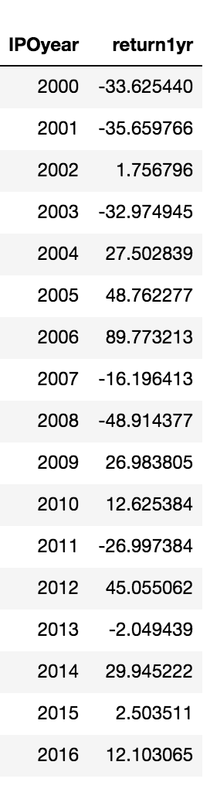
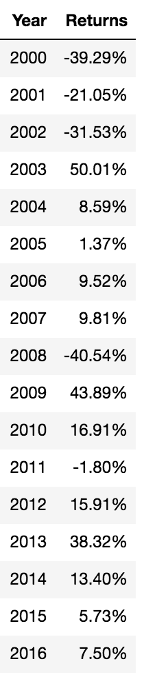
IPO 1 Year Returns IPO vs NASDQ 100
IPOs in our data diverged significantly from the average return of the NASDAQ in some years

Slide 9
Our Conclusion
- SOME - IPOs still offer outsized returns, but the overall returns average closer to the mean of the market as a whole
Average returns for IPOs very widely by year, subsector and
Market data is complex, dirty and difficult to manipulate

Slide 10
With More Time…
- IPO On-Ramp
Remove Outliers
More sectors, tickers and years!

